Slide 1
Developing Effective Community Health Education Outreach Programs for Adults with Low Health Literacy
Khaliah Fleming, MPH,CHES
Venessa Rivera Colon, M.Ed, CCHW
Tampa Bay Community Cancer Network
(TBCCN) & Moffitt Program for Outreach Wellness Education and Resources (M-POWER)
H. Lee Moffitt Cancer Center & Research Institute

Slide 2
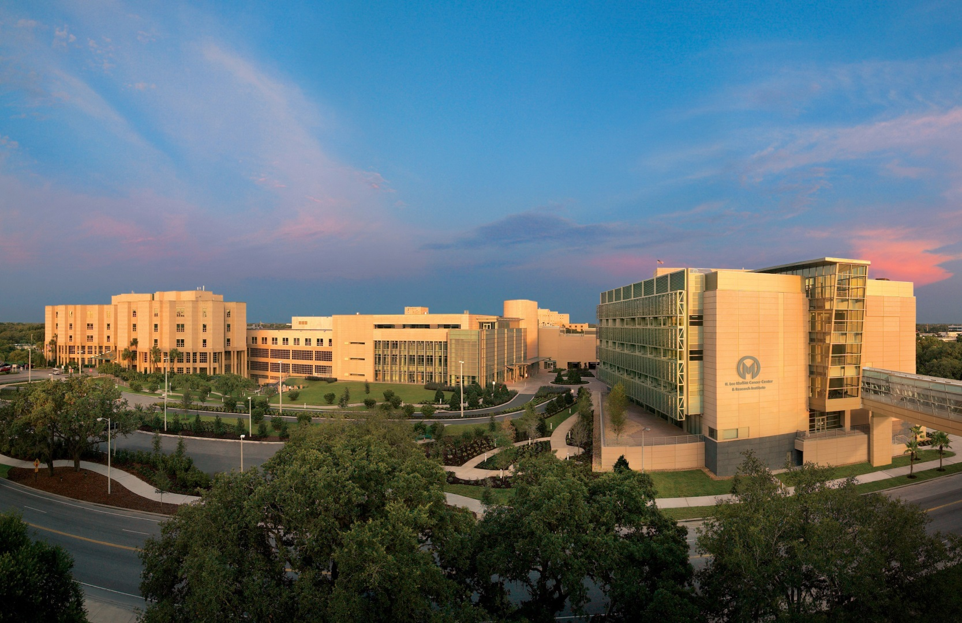
Moffitt Cancer Center
MISSION: To contribute to the prevention and cure of cancer

Slide 3
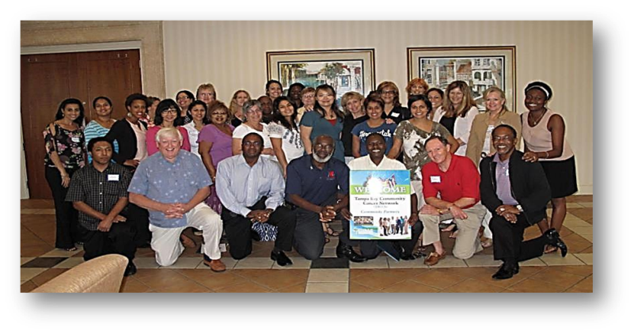
What is TBCCN?
Regional network of 28 community-academic partners
Addresses cancer health disparities within the Tampa Bay area for diverse medically underserved populations
Provides innovative training, research, and educational programs that recognize the importance of culture and literacy in cancer care

Slide 4
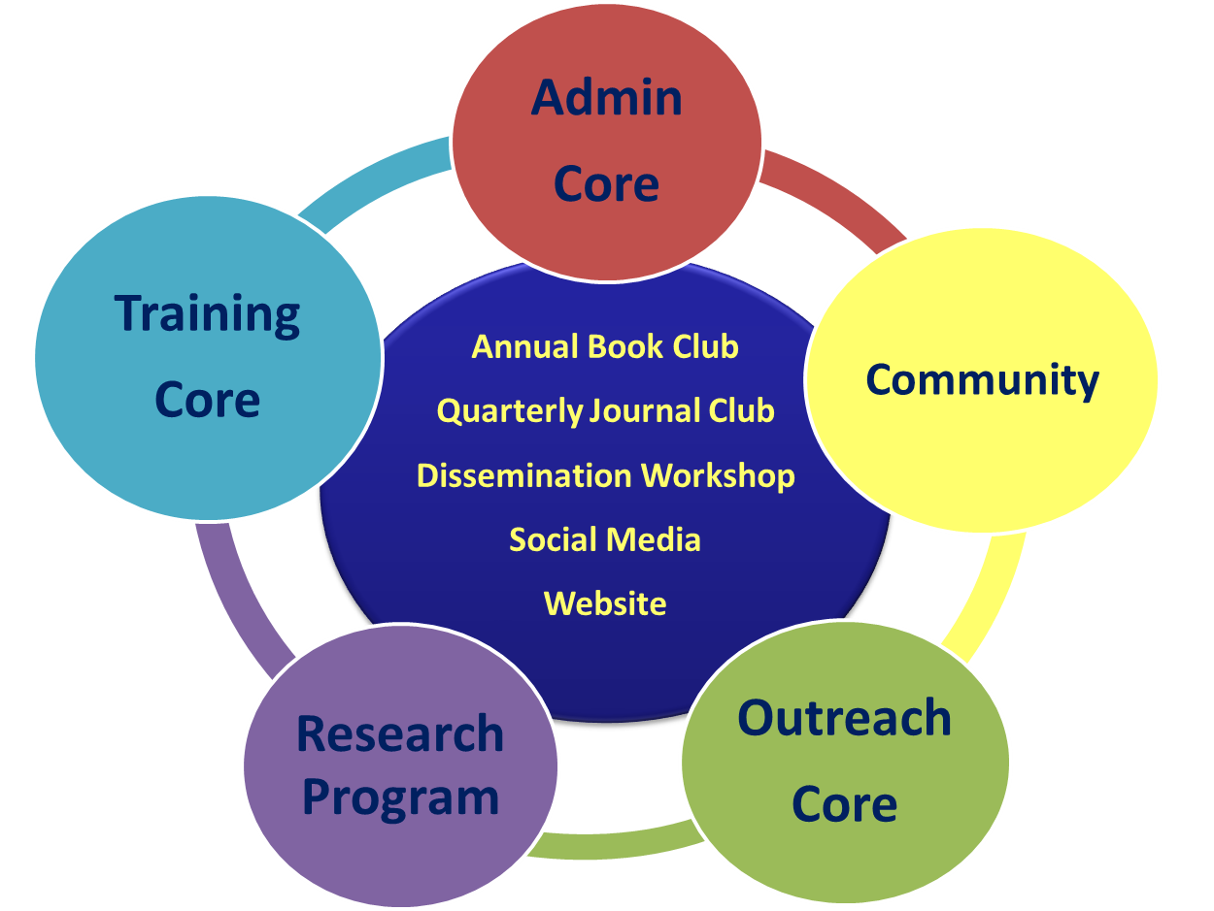
TBCCN

Slide 5
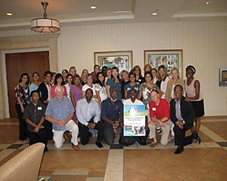

CARES Study
Colorectal Cancer Awareness, Research, Education and Screening (CARES)
Is a 2 phase research study that addresses disparities in CRC among populations attending community-based clinics.
Full Research Project (CARES: Colorectal Cancer Screening)
5 years
(C. Gwede/C. Meade)
Phase I (year 1):
Phase II (years 2-5):
Formative/Development of (CARES) Intervention Tool Kit
Randomized Controlled Trial (RCT)/Efficacy

Slide 6


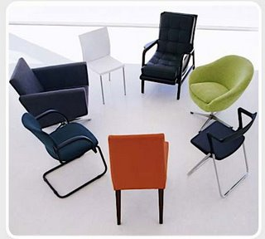
Phase I (Year 1): Formative/Development
Aim 1: To develop a low literacy colorectal cancer screening educational primary intervention (CARES) tool kit (novella DVD/booklet) N=94
FORMATIVE
(Mos. 1-4)
DEVELOPMENT
(Mos. 5-12)
5-8 Focus groups with clinic patients; N=53
Key informant (KI) interviews or focus groups w/ providers & staff (N=17)
CARES Novella DVD and Booklet
Iterative Learner Verification (N=24)
Phase II: RCT

Slide 7
CARES Tool Kit (Photo novella and DVD)
A novella is video or print media that contains narrated storylines
Includes characters that model the behavior for which it is designed
Development of the photo novella and DVD:
Our community stakeholders which includes members of the target group and other community partners felt the information that already exists was not sufficient because existing materials:
(1)Were not inviting; were not easy to read or culturally targeted for underserved populations, not stylish, not culturally right for me
(2)Not catchy or unique enough to “compel” me to want to read or view them.

Slide 8

Lessons learned
Ongoing community partner guidance and involvement is vital to the success of the research study.
Utilize the expertise of the CAB to provide guidance and feedback of design and dissemination efforts.
Translating research jargon into easy-to-understand information.
Adaptability and flexibility to accommodate changes in clinic workflow, staffing, hours or patient schedules.
Time is always a great challenge when creating a product with the help of the community.

Slide 9
TBCCN-CCER
NCI-funded National Outreach Network Supplement
Drawing on the formative work of our cervical cancer patient navigator (PN) AARA supplement
Enhance our CC education efforts through CHE-directed development and evaluation of a low literacy TBCCN Cervical Cancer Education Resource (TBCCN-CCER).
Overall goal of this project is to create and evaluate a CCER. The project : 1) builds on findings from our TBCCN ARRA cervical cancer navigation supplement; and 2) augments the current parent grant’s outreach focus for creating innovative evidence-based educational products within a CBPR framework.

Slide 10
TBCCN-CCER Specific
Aims & Research Design
Specific Aim 1: To modify and finalize a culturally appropriate low literacy CC patient education resource to specifically meet the learning needs of Hispanic women from a local farmworker community (Phase 1).
Specific Aim 2: To conduct preliminary testing of the effectiveness of the TBCCN-CCER. (Phase 2).
Research Design
Initial Draft Modification of the TBCCN-CCER
Learner Verification Interviews
Baseline Survey (Pap Test Beliefs, HPV Knowledge, Cervical Cancer Screening Self-Efficacy Scale, Pap Test Intentions, and health Literacy)
Educational Session
Post Survey (Pap Test Beliefs, HPV Knowledge, Cervical Cancer Screening Self-Efficacy Scale, and Pap Test Intentions)

Slide 11
TBCCN Biobanking Informational display
Specific Aim : To create a culturally and linguistically appropriate low literacy biobanking education resource to specifically meet the learning needs of community members.
Design
Seeking partner input/feedback on display content
Initial drafting of content cards
Learner verification questioning with partners and team members
Revision of display panels (cards)
Shared at various community events with ongoing feedback from participants

Slide 12
Lessons Learned
Colors
Phrases/Vocabulary
Text Size
Font
Ease of Understanding Content
Designs
Medical Images
Images of People

Slide 13
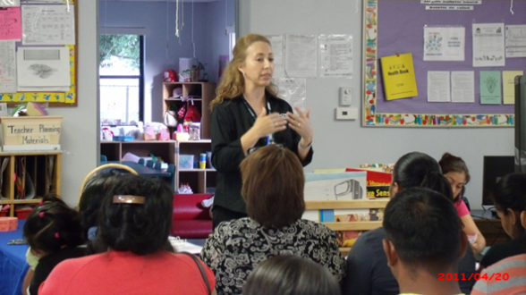
M-POWER
To increase and deepen community relationships through partnership building.
To provide education on the prevention of cancers through health education.
To provide access to resources for cancer screenings and treatment.

Slide 14
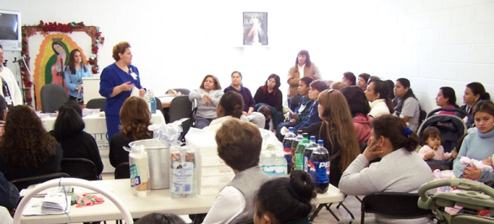
M-POWER
Team consists of Community Health Workers, Patient Navigator, and Health Educator
Focus on underserved communities:
  Racial/Ethnic Minorities
  Low SES
  Rural
  Non-English Speakers
  Farmworkers

Slide 15
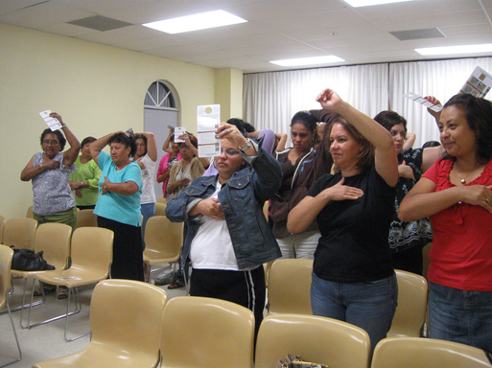
Workshops
Workshops provided in English and Spanish
  Breast, Colon, Cervical, Prostate, Lung, Skin, HPV, Healthy Lifestyles
  Utilize ARS to conduct Pre-post
  test and Evaluation
  Follow-up is provided for
  screening services

Slide 16
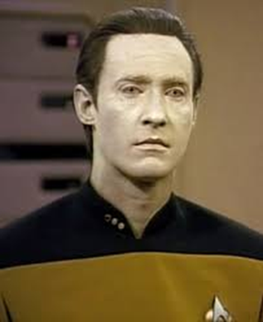
Benefits of Using an Audience Response System
More Interactive way of collecting data
Less time consuming
Confidential
Easier to identify number/letters as responses
Can use images or words- Likert scale

Slide 17
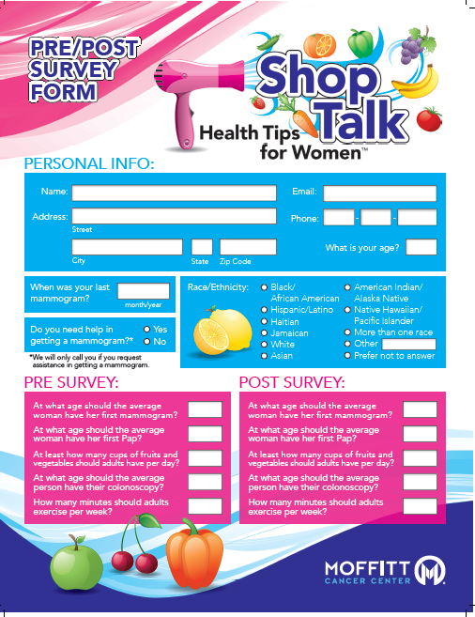
Shop Talk: Health Tips for WomenTM
Pilot
  4 stylists provide healthy lifestyles education to clients as they are waiting for their appointments, drying hair
  Clients view 5 minute video, complete pre and post test and are asked about mammography

Slide 18
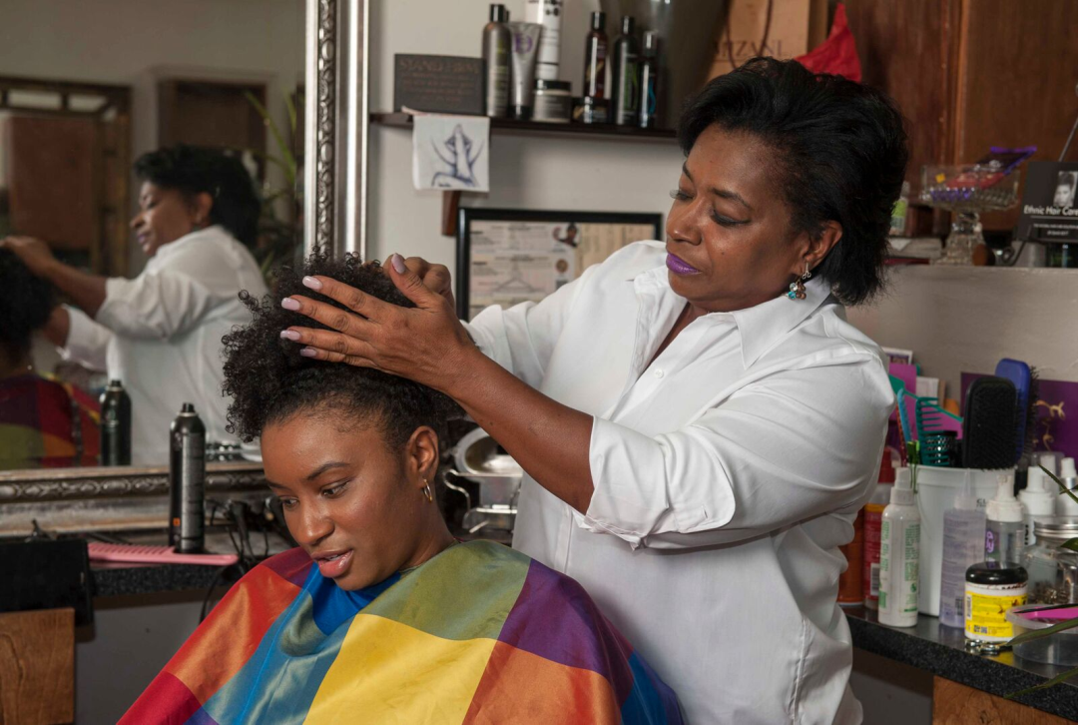
Shop Talk Results
302 completed pre/post test
  Average Pre-test score: 23.39%
  Average Post-test score : 78.00%

Slide 19
Shop Talk: Lessons Learned
Additional interest in education for stylist
Tech support is needed
Incentives are helpful but not always the reason for involvement
Small group of stylists is more manageable

Slide 20

Healthy Lifestyles Journal
Vital to increase knowledge about healthy lifestyles and cancer prevention among racial/ethnic minorities using culturally and linguistically appropriate-methods.
Studies have found that the use of community based participatory research can positively affect community compliance with health interventions within minority populations.
Notes:
1/3 of cancer deaths could be prevented through healthy lifestyle behaviors

Slide 21
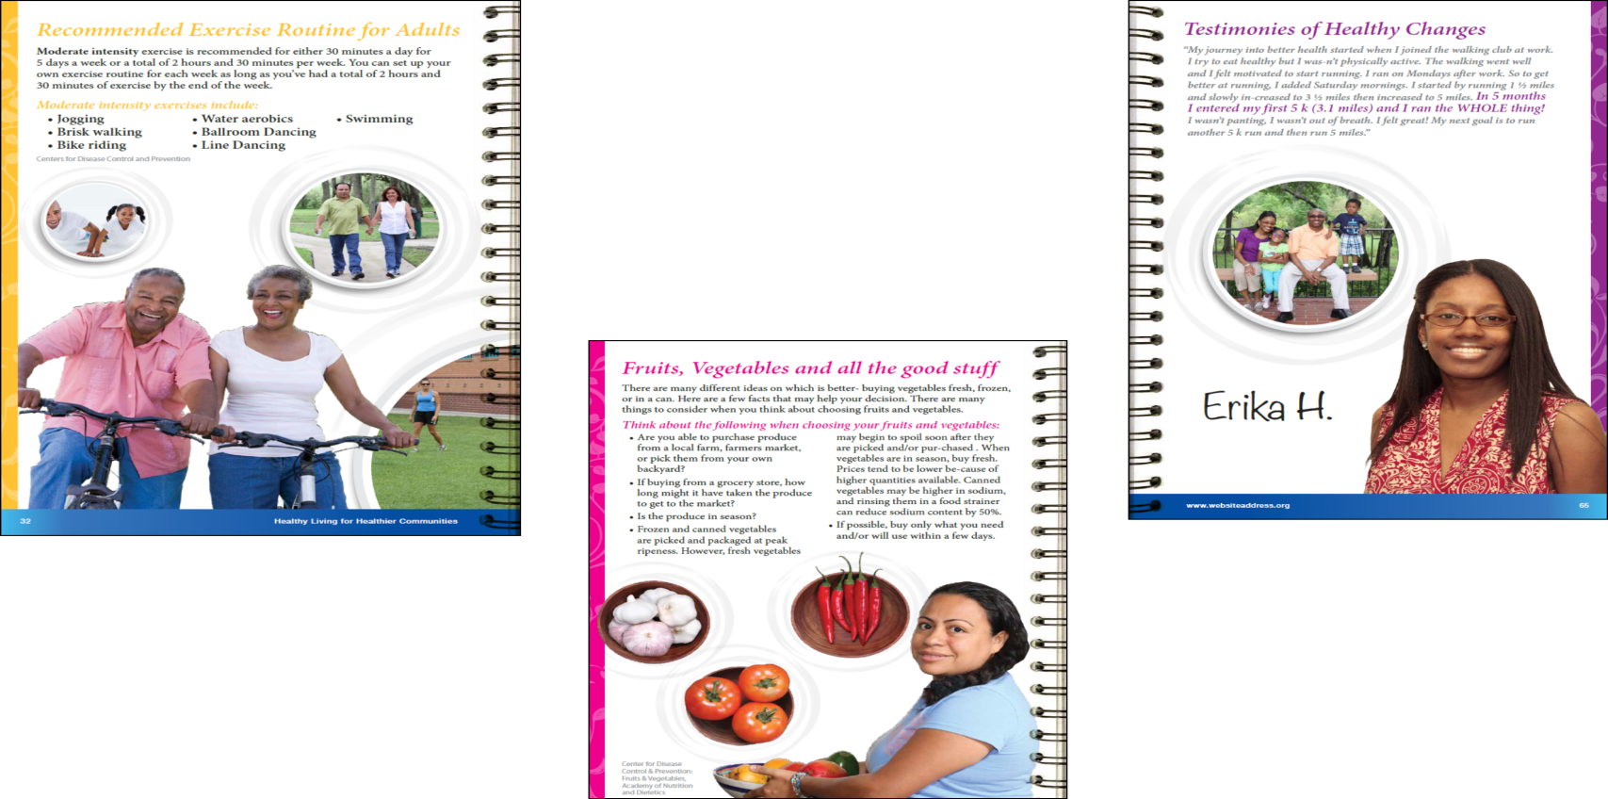
Healthy Lifestyles Journal
Purpose: Develop an evidence-based toolkit based on the opinions of community members in order to provide knowledge about healthy lifestyles and cancer prevention

Slide 22
Development of Journal
The process was adopted from the National Cancer Institute’s Clear & Simple: Developing Effective Print Materials for Low-Literate Readers Guidelines
Four focus groups, total of 61 participants
The emerging themes were used to formulate the concepts and content
Notes:
Define the target audience; Conduct target audience research; Develop a concept for the product; Develop content and visuals; and Pretest and revise draft materials
Participants were recruited with the help of community partners and had to self identify as AA, Haitian, or Hispanic/Latino; speak and/or read English, Spanish, or Haitian Creole; and be adults 18 years or older.

Slide 23
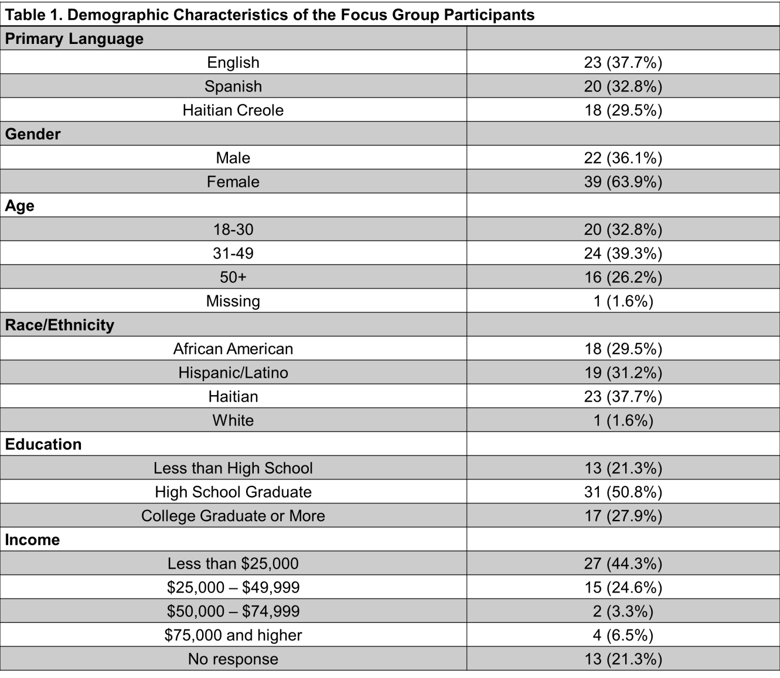
Demographics of focus groups

Slide 24
Emerging themes
Health: holistic approach, being able to do everyday activities, without illness, eating healthy, taking care of the body
Nutrition: information on how to prepare foods in a healthy way since some culturally, traditional ways can be unhealthy
Physical Activity: information on how to exercise in a practical way and show a variety of exercises
Smoking: information on the dangers of smoking and how to quit
Design of the toolkit: needs to be colorful, include images of real-looking people, pictures of serving sizes, testimonials from people who have made lifestyle changes, information about gardening, include a walking journal
Overall, participants were enthusiastic about a toolkit because it can be taken anywhere and provides education

Slide 25
Components of the journals
Journaling
Ways to cook your food
Five food groups
Traffic light
Importance of exercise
Reading a nutrition label
Shopping on a budget
Ways to be Healthy
Food diary

Slide 26
Lessons learned
Similarity in the topics of interest in the 3 communities
Differences in the aspect of design
  Less dark colors
  More images of community
  Very specific food types
  Removal of Yoga (inclusion of prayer)
  Younger people
  Less wording

Slide 27
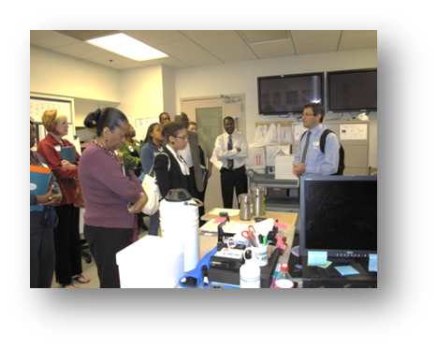
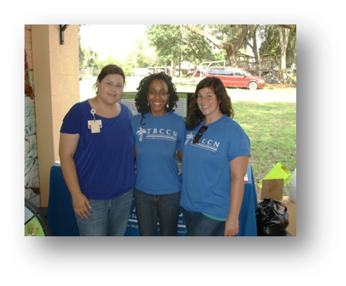
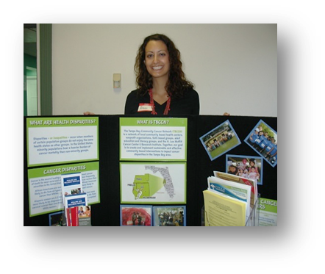
Thank you!
Khaliah Fleming, MPH, CHES
813-745-8864
Khaliah.Fleming@moffitt.org
Venessa Rivera Colon, M.Ed, CCHW
813-745-4306
Venessa.RiveraColon@moffitt.org

